Slide 1
TravelWorks
TravelPay Integration
Set-Up Information
Bank Account details in TravelWorks
Processing a Customer Payment
TravelPay Interface
Payment recorded on Customer Invoice

Slide 2
Set-Up Information
1. Obtain Credentials from TravelPay
Agency to contact TravelPay to request their Credentials + API Credentials
API Credentials
These API credentials are the same for both JQuery and for API authentication
Api_key =
Username =
Password =
TravelPay Support Team: info@travelpay.com.au

Slide 3
Set-Up Information
2. Credentials provided to TravelWorks
TravelPay will provide Credentials to TravelWorks/PC Voyages Canada with cc to the Agency and Black Sheep Tourism
To: TravelWorks/PC Voyages Canada: support@pcvoyages.com
Cc: Black Sheep Tourism: hello@blacksheeptourism.com.au
Cc: Your Agency email:
TravelWorks/PC Voyages will arrange the installation of the TravelPay Integration

Slide 4
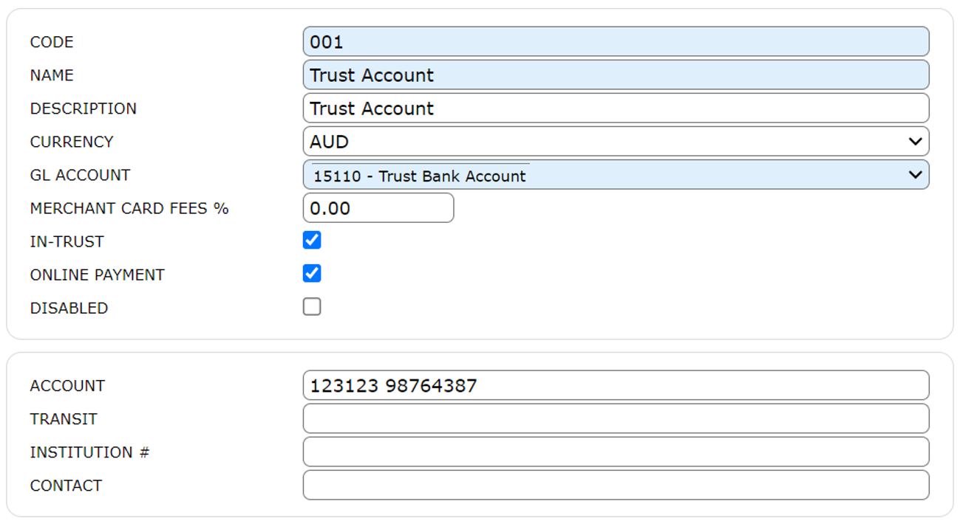
Enter Bank Account Details in TravelWorks
Bank Account details associated with TravelPay must be correctly housed in TravelWorks to enable payment processing
System Configuration > Bank Accounts

Slide 5
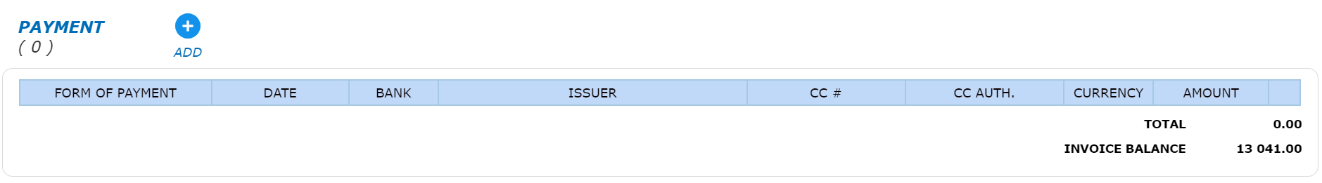
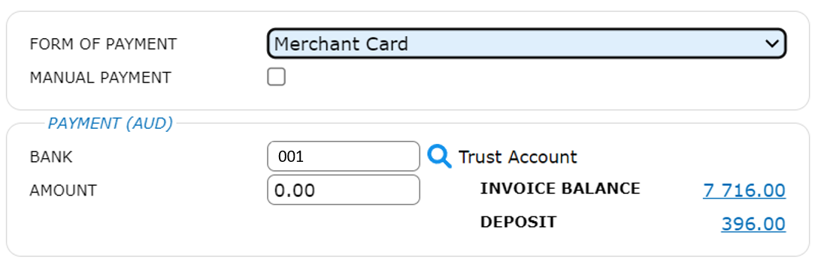
Processing a Customer Payment
Invoicing > Invoices: select the invoice, scroll down to the Payment section, select Add
Select Merchant Card and Bank Account – this must be the Bank Account set up as Online Payment
13,041.00
7,500.00
Click OK, and you will be directed to the TravelPay site

Slide 6
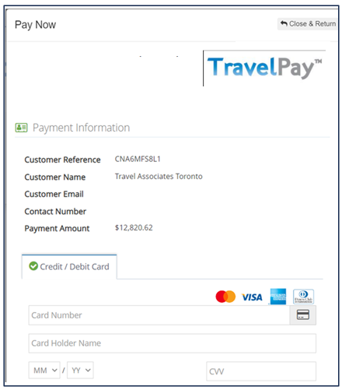
TravelPay Interface
Enter
Customer Details
Amount to be Paid
Credit Card Information
Once Processed, a Payment Confirmation will be received from TravelPay

Slide 7
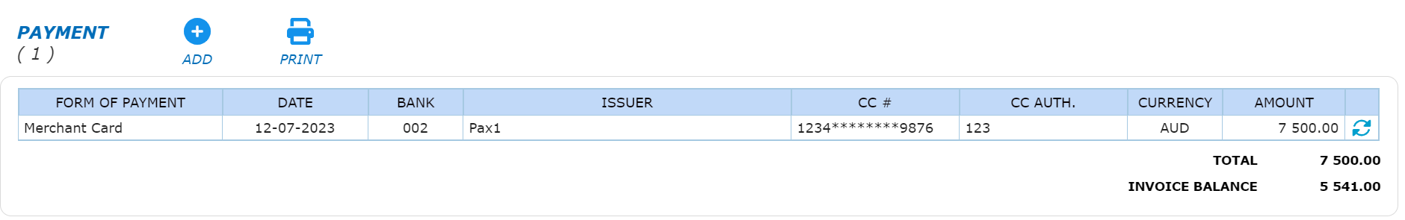
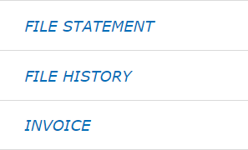
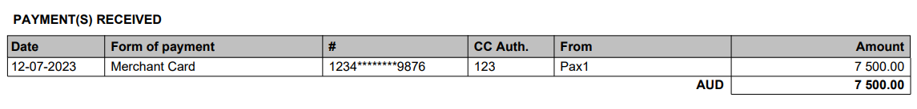
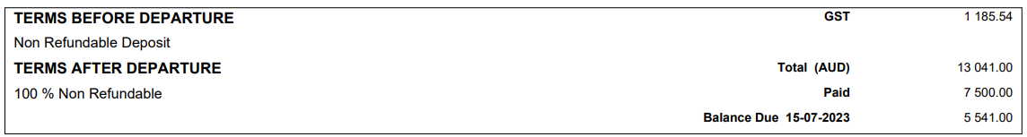
Payment Shown on Customer Invoice
Payment Section of Customer Invoice
From Customer Invoice: Print > Invoice

